Slide 1
Production and Costs
Firms use inputs to produce outputs. The production function describes the relationship between inputs and output.
Q = F(K,L,…)
Q = Quantity of output produced
K = Amount of capital input
L = Amount of labor input
… = A list of other inputs used
F(K,L,…) is the maximum feasible output from the given inputs.

Slide 2
Example 1
A utility produces electricity from coal and natural gas. Each ton of coal produces 60-kilowatt hours, each 100 cubic meters of gas produces 40-kilowatt hours
Q=60C+40G

Slide 3
Example 1
A utility produces electricity from coal and natural gas. Each ton of coal produces 60-kilowatt hours, each 100 cubic meters of gas produces 40-kilowatt hours
Q=60C+40G
Example 2
The number of insurance claims processed in a day is
Q=K^{1/2}L^{1/2}
K=total computer power,
L= number of claims workers.

Slide 4
Isoquants
One way of describing the production function is a table.
K
\
L
1
2
3
4
5
1
20
40
55
65
75
2
40
60
75
85
90
3
55
75
90
100
105
4
65
85
100
105
115
5
75
90
105
115
120
Many different combinations of K and L produce 75 units. We can graph them using a smooth line.

Slide 5
Capital per year
3
2
1
Q=55
1
2
3
Labor
The smooth line joining input combinations that produce the same quantity of output is called an isoquant.

Slide 6
Capital per year
3
2
Q=75
1
Q=55
1
2
3
Labor
The smooth line joining input combinations that produce the same quantity of output is called an isoquant.

Slide 7
Capital per year
3
2
Q=90
Q=75
1
Q=55
1
2
3
Labor
The smooth line joining input combinations that produce the same quantity of output is called an isoquant.

Slide 8
Isoquants show the flexibility of the firm's production process
Example:
Draw the isoquant for 1200-kilowatt hours of the electricity production technology.

Slide 9
Isoquants show the flexibility of the firm's production process
Example:
Draw the isoquant for 1200-kilowatt hours of the electricity production technology.
Set 1200 =60C+40G and plot –
20
Isoquant for 1200 kilowatt hours
30
100's of cubic meters

Slide 10
One Variable Input: The Short Run
The short run is the period of time over which some inputs remain fixed (buildings, machinery), while other inputs can change (raw materials, labor).

Slide 11
One Variable Input: The Short Run
The short run is the period of time over which some inputs remain fixed (buildings, machinery), while other inputs can change (raw materials, labor).
The long run is defined to be the time period over which all inputs can vary.

Slide 12
Question: If we fix capital and vary the labor used what happens to output?
L
K
Q
Q/L
ΔQ/ΔL
0
10
0
-
-
1
10
10
10
10

Slide 13
Question: If we fix capital and vary the labor used what happens to output?
L
K
Q
Q/L
ΔQ/ΔL
0
10
0
-
-
1
10
10
10
10
2
10
30
15
20

Slide 14
Question: If we fix capital and vary the labor used what happens to output?
L
K
Q
Q/L
ΔQ/ΔL
0
10
0
-
-
1
10
10
10
10
2
10
30
15
20
3
10
60
20
30

Slide 15
Question: If we fix capital and vary the labor used what happens to output?
L
K
Q
Q/L
ΔQ/ΔL
0
10
0
-
-
1
10
10
10
10
2
10
30
15
20
3
10
60
20
30
4
10
80
20
20

Slide 16
Question: If we fix capital and vary the labor used what happens to output?
L
K
Q
Q/L
ΔQ/ΔL
0
10
0
-
-
1
10
10
10
10
2
10
30
15
20
3
10
60
20
30
4
10
80
20
20
5
10
95
19
15

Slide 17
Question: If we fix capital and vary the labor used what happens to output?
L
K
Q
Q/L
ΔQ/ΔL
0
10
0
-
-
1
10
10
10
10
2
10
30
15
20
3
10
60
20
30
4
10
80
20
20
5
10
95
19
15
6
10
108
18
13

Slide 18
Question: If we fix capital and vary the labor used what happens to output?
L
K
Q
Q/L
ΔQ/ΔL
0
10
0
-
-
1
10
10
10
10
2
10
30
15
20
3
10
60
20
30
4
10
80
20
20
5
10
95
19
15
6
10
108
18
13
7
10
112
16
4

Slide 19
Question: If we fix capital and vary the labor used what happens to output?
L
K
Q
Q/L
ΔQ/ΔL
0
10
0
-
-
1
10
10
10
10
2
10
30
15
20
3
10
60
20
30
4
10
80
20
20
5
10
95
19
15
6
10
108
18
13
7
10
112
16
4
8
10
112
14
0

Slide 20
AP_{L} = average product of labor (Q/L)
(Productivity)

Slide 21
AP_{L} = average product of labor (Q/L)
(Productivity)
MP_{L} = marginal product of labor (ΔQ/ΔL)
(These are both computed for a given amount of capital!)

Slide 22
AP_{L} = average product of labor (Q/L)
(Productivity)
MP_{L} = marginal product of labor (ΔQ/ΔL)
(These are both computed for a given amount of capital!)
• Both AP_{L} and MP_{L} first increase and then decrease as L goes up.

Slide 23
AP_{L} = average product of labor (Q/L)
(Productivity)
MP_{L} = marginal product of labor (ΔQ/ΔL)
(These are both computed for a given amount of capital!)
• Both AP_{L} and MP_{L} first increase and then decrease as L goes up.
• The fact that MP_{L} eventually goes down is called the "Law of Diminishing Returns". (Extra units of labor increase output at a decreasing rate.)

Slide 24
General features of this relationship.
(1) If MP_{L} >AP_{L} then AP_{L} is going up.
(2) If MP_{L} < AP_{L} then AP_{L} is going down.
Output
Produced
Marginal Product
Average Product
Quantity of Labor

Slide 25
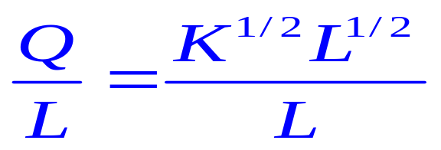
Productivity
For a given production function Q=K^{1/2}L^{1/2}, we can calculate average and marginal product of labor.
(1) Average product AP_{L} =
• This is called "Labor Productivity". International comparisons of productivity use this measure. (This is a short run concept!)

Slide 26
Questions:
What is the main determinant of this?
What determines productivity growth? (Agriculture/Services/Mining?)
Germany
Japan
USA
Output per person (1995)
22,373
21,269
26,183
Years
Rate of growth of AP
L
1960
-
73
4.06
8.2
1.93
1974
-
86
1.86
2.73
0.35
1987
-
95
1.60
1.77
1.01

Slide 27
Different Productivity Growth Rates
The “Industrial Revolution” in Europe occurred in part because productivity grew in agriculture so not every worker needed to produce food.
Productivity grew faster than the population,
=>
The number of workers in the farming sector shrank.
Signs in China …

Slide 28
Different Productivity Growth Rates
Today (before the financial crisis)…
Productivity grows in the USA at 3% per year.
(output per worker)
But
Productivity in manufacturing grows at least 5% per year.

Slide 29
Different Productivity Growth Rates
Today …
Productivity grows in the USA at 3% per year.
But
Productivity in manufacturing grows at least 5% per year.
Results:
The USA manufacturing sector must shrink (unless it can export more).
The average USA citizen spends 2% less each year on manufactured products.
… and they spend a bigger share of their income on products with slow productivity growth (health, education etc.).

Slide 30
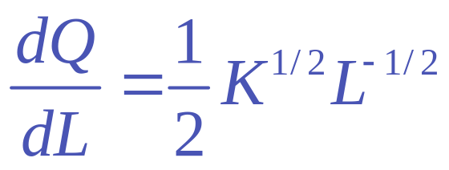
Marginal Product
MP_{L} =
In this example MP_{L} <AP_{L} so AP_{L} is going up or down?

Slide 31
The Law of Diminishing Returns and Starvation (Malthus)
Thomas Malthus thought that a fixed amount of land, increasing labor and the law of diminishing returns meant that eventually we could not produce enough food to feed everybody.
What’s wrong?
He forgot that food production also requires capital and that
the quantity and quality (through technical progress) of
capital increases. In fact, food production per person has
increased.

Slide 32
World Food Consumption per person
1950 100
1960 115
1970 123
1980 128
        1990 137
What happens is that capital increases shifting up the relationship between labor and output.

Slide 33
Productivity in Action
Recently there has been a decline employment in OECD countries (the newspapers were sad about this)

Slide 34
Productivity in Action
Recently there has been a decline employment in OECD countries (the newspapers were sad about this)
At the same time there has been an improvement in productivity (the newspapers celebrated this)

Slide 35
Productivity in Action
Recently there has been a decline employment in OECD countries (the newspapers were sad about this)
At the same time there has been an improvement in productivity (the newspapers celebrated this)
Why does the one necessarily lead to the other!!

Slide 36
Profit Maximization
What is the optimal quantity of labor for the firm to use?
In the short run, each extra unit of labor generates MP_{L} extra units of output. This can be sold to obtain MR (marginal revenue) extra units of revenue, so the extra revenue from the extra labor is
(MR)(MP_{L}) = MRP_{L}
The extra cost of a unit of labor is the wage w.
To maximize profit MRP_{L}=w.

Slide 37
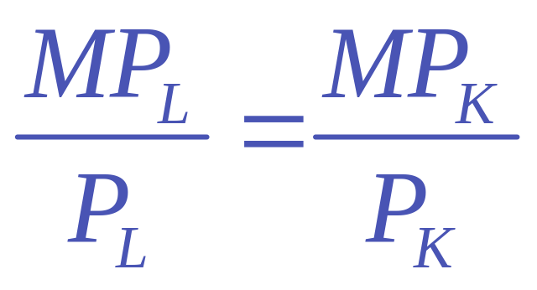
The Long Run: All Inputs are Variable
If firms use different combinations of K and L to produce a given level of output, the best combination of K and L satisfies
.

Slide 38
The Long Run: All Inputs are Variable
If firms use different combinations of K and L to produce a given level of output, the best combination of K and L satisfies
Why? Suppose that the ratio on the left was bigger than the one on the right. Then $1 extra spent on labor produces more than $1 extra spent on capital, so the firm could spend an extra $1 on labor and reduce more than $1 on capital and still produce the same quantity of output.
.

Slide 39
Consider a firm with two Inputs L and K, when wages = 2 and the rental cost of capital = 3. Then its total cost satisfies
Total Cost = 2L+3K
2L+3K=20 is the line that joins combinations of K and L with the same cost these are called isocosts
2L+3K=20
L
K

Slide 40
Consider a firm with two Inputs L and K, when wages = 2 and the rental cost of capital = 3. Then its total cost satisfies
Total Cost = 2L+3K
2L+3K=20 is the line that joins combinations of K and L with the same cost these are called isocosts
2L+3K=20
L
2L+3K=10
K

Slide 41
Suppose first you wanted to produce 3 units of output then at a cost of 20 there are two ways of doing this
2L+3K=20
L
Isoquant
for Output =3
K

Slide 42
At a cost of 10 there are two ways of doing this
2L+3K=20
L
2L+3K=10
Isoquant
for Output =3
K

Slide 43
At the lowest possible cost there is only one way and the isocost and isoquant have the same slope.
2L+3K=20
L
2L+3K=10
Isoquant
for Output =3
Cost Minimizing
K and L
K

Slide 44
At the cost minimizing point the slope of the isocost line equals the slope of the isoquant line. This is exactly the same condition as

Slide 45
What happens if the price of capital increases?
2L+3K=20
L
K

Slide 46
This makes the Isocost line steeper
2L+3K=20
L
2L+4K=20
K

Slide 47
What happens if the price of capital increases?
The firm switches out of capital into labor
L
Old Cost Minimizing
K and L
K

Slide 48
What happens if the price of capital increases?
The firm switches out of capital into labor
L
New Cost Minimizing K and L
Old Cost Minimizing
K and L
K

